Slide 1

Healthy Eating Keeps Doctors Away
Submitted to : Tiffany A. Koszalka, Ph.D.
Professor of Instructional Design, Development and Evaluation
IDE 756 Design of Online Courses
Team1: Halo
December 31
Lei Wang Hannah Goldberg Andrejas Duerig

Slide 2
An online introductory training course for clients in a non-profit health center to solve weight related health issues and develop healthy eating habits with the guide of Choose My Plate program, which is a nutrition model created by the U.S. Government.
Title: Healthy Eating Keeps Doctors Away Estimated Time: 120 minutes
Purpose:
Context:
The clients of a non-profit health center are suffering weight related health issues. Most of them are English speaking adults with at least 10th grade reading level. Younger children may learn with their adults. They have basic to advance technology skills and are motivated to learn by their counselors but lack knowledge of healthy eating habits. To get them actively involved in the content of USDA nutritional guidelines, a self-paced program is designed to prompt the clients to develop their healthy eating habits. The learning materials are from USDA nutrition guidelines on Choose My Plate. The clients will be guided through a variety of activities online and offline to identify ways and create tangible tools so that they can develop healthy eating habits for life.
Overview:
This storyboard presents the flow of activities for a 120-minute training session on engaging the clients in the USDA nutritional guidelines and developing healthy eating habits. The sessions include …Introduction…Analysis…Demonstration…Assessment.
This storyboard includes four units with various events. Learners will gain points and badges according to their performances for each unit. Some events are required to complete after the instruction offline. The design will foster learners to achieve the desired learning outcomes.
The Introduction starts with welcome email and followed by overview and introduction to the course and Blackboard system. Analysis focuses on Participate Bio, in which instructor can identify their learners’ detailed information and the gap between their current situation and expected outcomes. Next, learners will give us a Demonstration by redesigning MyPlate icon and checklist for shopping with instruction. Lastly, instructor will create assessments on learners’ achievements.

Slide 3
Title: Healthy Eating Keeps Doctors Away Estimated Time: 120 minutes
Expected outcomes:
By the end of this online learning course,100% of the learners will be able to :
define the concept “What is MyPlate? “by watching tutorials and reading USDA’s nutritional guidelines.
identify healthy eating patterns by reading online articles and discussion with peers and instructor.
use key elements of healthy eating patterns to construct the knowledge base of MyPlate by redesigning MyPlate icon in teams.
create a healthy grocery checklist for families by combining healthy food choices with calorie limits from USDA’s nutritional guidelines.
Value the meal choices by asking a USDA expert and writing a reflective journal to make shifts in the current daily choices to align with USDA’s nutritional guidelines.
Resources: Laptop/computer/tablet/smartphone, Internet connection, Syllabus, Online videos, Articles/PDF’s, Simulations, Quizzes, Padlet, Mindmaister, tutorials, Internet connection, videoconferencing software, websites, Infographics, rubrics, checklist, guidelines, Google Products
Facilities: Online: Blackboard （Bb)
Stakeholders: Online instructor( monitor); Non-profit health center clients (can be adults, young adults or adolescent, children); Families of the clients; Board of the clinic; Administrators of the clinic; Health care providers;

Slide 4
Title: Healthy Eating Keeps Doctors Away Estimated Time: 120 minutes
Purpose: An online introductory training course for a non-profit health center, who wants to instruct their clients on Choose My Plate program, which is a nutrition model created by the U.S. Government to solve weight related health issues and develop good eating habits.
Flow of this program: The flow of activities for a 120-minute training sessions includes…Analysis…Demonstration…Assessment. All the sessions with various activities are built under the roof of Choose My Plate in a linear sequence to help learners build healthy eating habits.
Flowchart of online course:
Redesign the icon MyPlate
Post-demo Quiz
Build 3 Healthy Meals for One Day
Create a Healthy Grocery List for Families
Choose My Plate
Introduction to Online Course
Overview of Blackboard System
1
4
Relationship Management
2
3
Participate Bio
20 min
All about My Meal Choices
Course Evaluation
Reflective Journal
20 min
55 min
25 min
Introduction
Analysis
Demonstration
Assessment
Healthy Eating Pedagogical & Technical Infrastructure
The following storyboard screens will elaborate key activities in each step of the flowchart.

Slide 5

Course Title: Healthy Eating Keeps Doctors Away Estimated Time: 3 minutes（pre-work）
Activity Title: Introduction to Online Course—Introduction Email—1.1a
Christin.(2016). How To Write The Perfect Introduction Email And What Not To Say[Digital image]. Retrieved from https://www.getmailbird.com/introduction-email-2/ | Instructional Activity Description: Email the learners who enrolled in this online course. Greetings to the learners and get them know you are excited and ready to teach them. Provide information to log into the course by using Bb. Overview of design of the course.’ Suggestions from the instructor.
 | Activity Deliverables/Outcomes: NA
 | Resources Required: Personal laptops/computers/ tablets/ smartphones Fast and stable Internet connection
Notes: Get access to one institution’s Blackboard before sending introduction email and assign the learners account information. Send the email a week earlier before the official start date to provide more time for the learners to be well prepared. Learners will have account information to log in Bb. | Key learning outcomes: NA
 | Key Content Points: NA
Introduction
Analysis
Demonstration
Assessment
Hello, welcome to...

Slide 6

Introduction to Online Course— Syllabus—1.1b
Course Title: Healthy Eating Keeps Doctors Away Estimated Time: 5 minutes
Activity Title:
 | Instructional Activity Description: Presents academic calendar Provides clear goals and teaching procedures. Introduces points, badges and leaderboards during the training process. Presents the content materials Choose MyPlate Learners will be able to generalize the distribution of points values and their corresponding rewards.
 | Activity Deliverables/Outcomes: NA
 | Resources Required: Personal laptops/computers/ tablets/ smartphones Fast and stable Internet connection Technology skills and account information to log in Bb.
Notes: Introduce the game-like features in this online course. Learners will gain points and badges based on the achievements of the following tasks :participation, challenges, quizzes,, progress report, feedback, assignments and surveys. Syllabus contains rubrics to guide students to perform well in each unit. Throughout the online course, learners will experience gamification's effects and sustain engagement. Syllabus should also include course policies, rules and regulations to keep the course run smoothly. | Key learning outcomes: Learners will be able to describe USDA ChooseMyPlate.
 | Key Content Points: Overview of ChooseMyPlate
Introduction
Analysis
Demonstration
Assessment
Gannon. K. (n.d.). How to Create a Syllabus[Digital image].Retrieved from https://www.chronicle.com/interactives/advice-syllabus

Slide 7
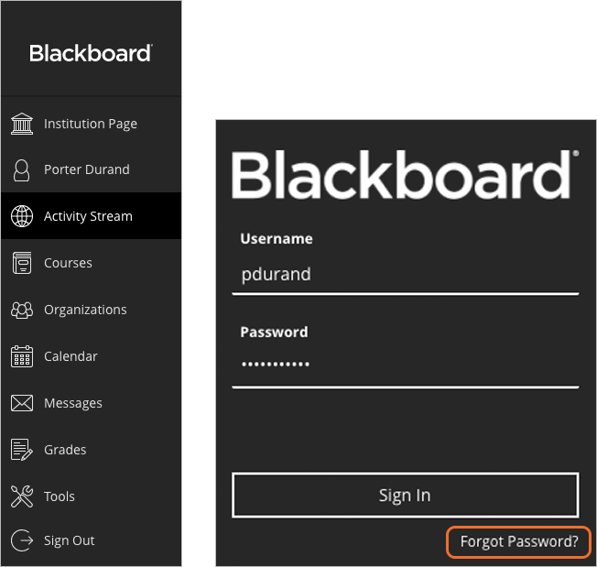
Overview of Blackboard System—Login to Site and Navigation—1.2a
Course Title: Healthy Eating Keeps Doctors Away Estimated Time: 5 minutes
Activity Title:
 | Instructional Activity Description: Tutorials about using Bb to log in. Browses the course basics.
 | Activity Deliverables/Outcomes : NA
 | Resources Required : Personal laptops/computers/ tablets/ smartphones Fast and stable Internet connection Technology skills and account information to log in Bb.
Notes: Bb is the platform used for this online course because it’s one of the popular learning management systems that includes communication, content delivery, and assessment tools to facilitate the teaching-and-learning process. | Key learning outcomes: NA
 | Key Content Points: NA
Introduction
Analysis
Demonstration
Assessment
Blackboard Help[Digital image]. (n.d.). Retrieved from https://help.blackboard.com/Learn/Student/FAQ/Login_Password_FAQ/

Slide 8
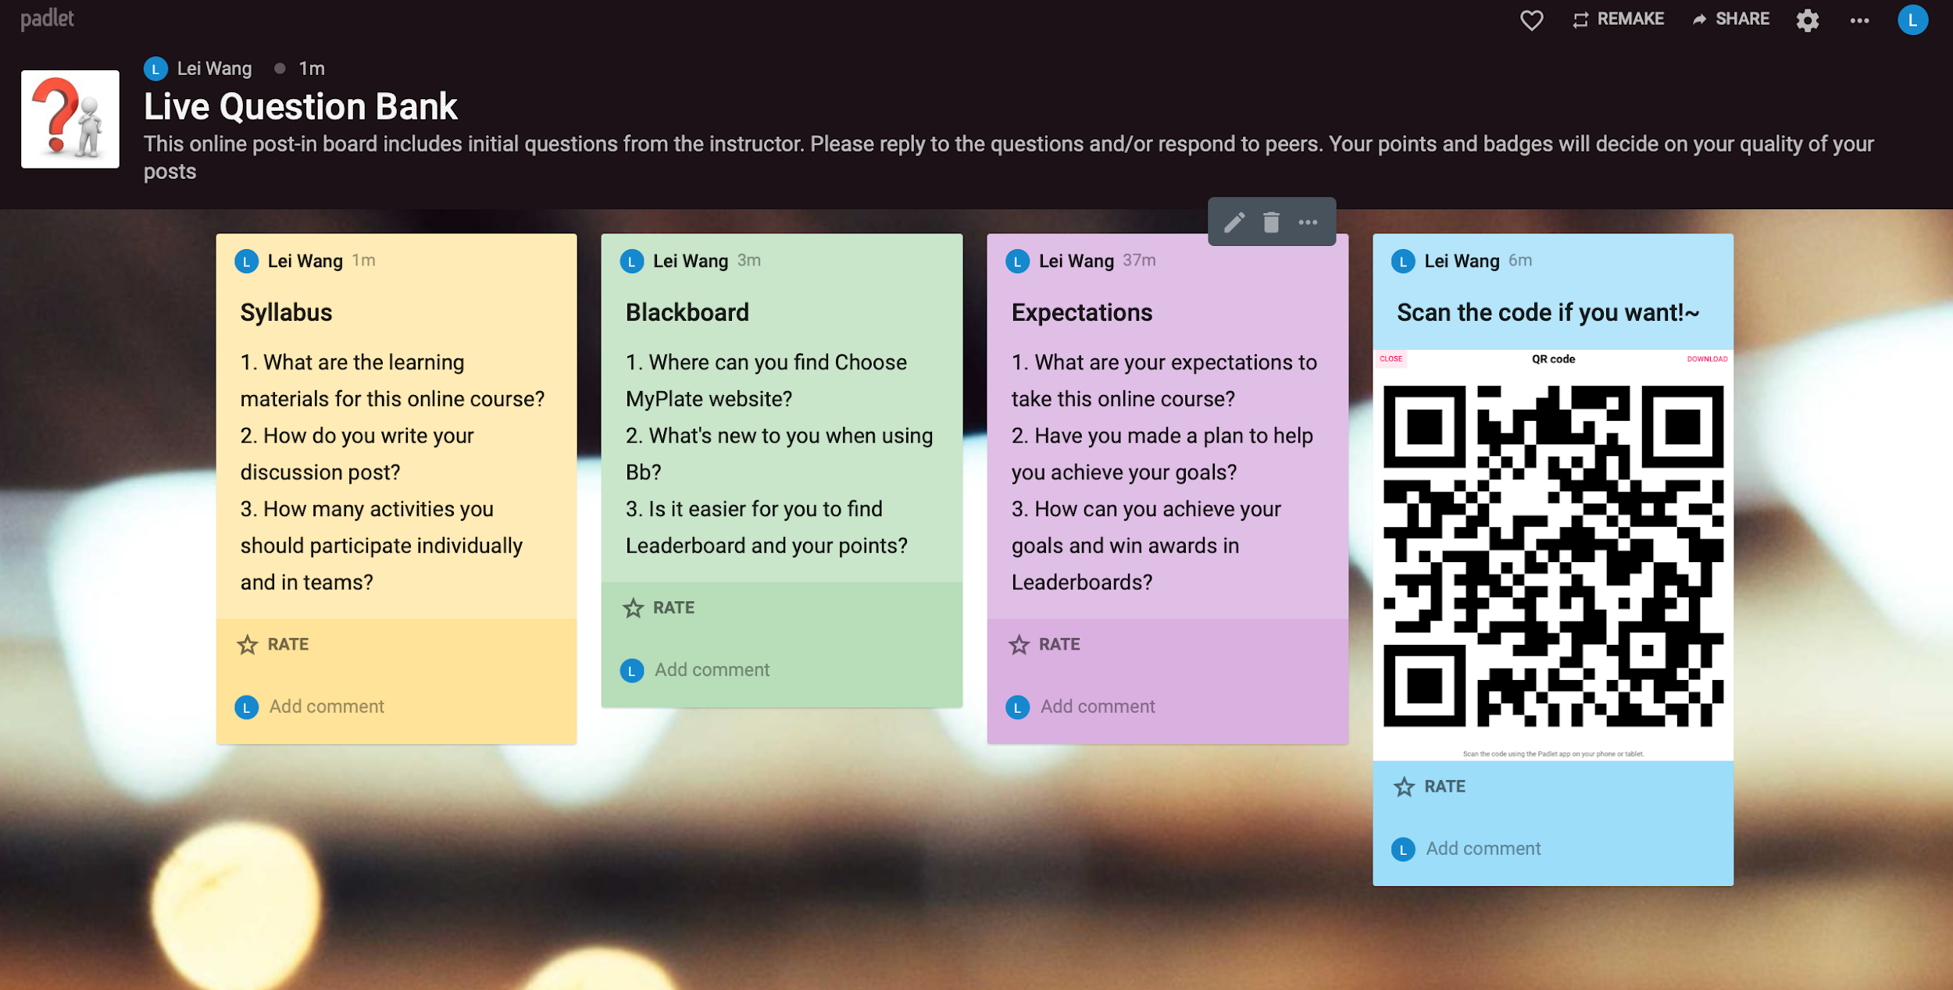
Course Title: Healthy Eating Keeps Doctors Away Estimated Time: 10 minutes
Activity Title:
Overview of Blackboard System—Live Question Bank —1.2b
 | Instructional Activity Description: Learners interact with instructor and peers online by asking and answer questions. Learners analyze key aspects of the course syllabus. Learners evaluate the skills of using Bb. Learners solve any question they may have.
 | Activity Deliverables/Outcomes : NA
 | Resources Required : Personal laptops/computers/ tablets/ smartphones Fast and stable Internet connection Padlet link:https://padlet.com/lwang69/jj7kh0pkgsj4 Provide QR code as an option to post and comment,
Notes: The link of this online post-in board will be posted in Unit 1 on Bb. By interacting with the instructor and peers, learners will digest syllabus and value whether they have reached the instructor’s expectations before they embark into the course deeper. Instructor will use the quality of posts to calculate the learners’ points according to the instruction of syllabus. Points and badges will be presented in Leaderboards to show how well the learners are doing and encourage them to highly engage in the following activity. | Key learning outcomes: NA
 | Key Content Points: NA
Introduction
Analysis
Demonstration
Assessment

Slide 9
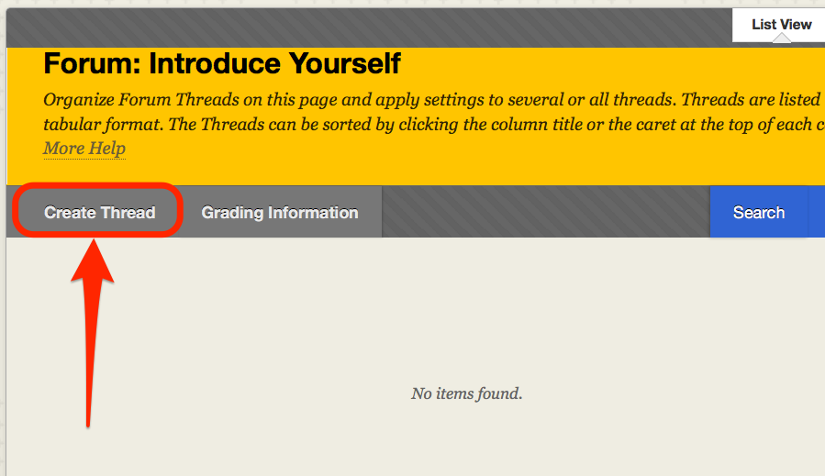
Participant bio—Self-introduction —2.1a
Course Title: Healthy Eating Keeps Doctors Away Estimated Time: 5 minutes
Activity Title:
 | Instructional Activity Description: Learners describe their current eating patterns. Learners define healthy eating patterns from their own perspectives. Learners follow the instructor’s very specific model to create their own bio.
 | Activity Deliverables/Outcomes: NA
 | Resources Required : Personal laptops/computers/ tablets/ smartphones Fast and stable Internet connection Instructor’s bio model
Notes: This activity is an essential to the online community building. The instructor’s model should include personal information, pictures, learning habits, personalities, family members, participant numbers in this online course in the family, understanding of healthy eating patterns and current personal/family eating patterns. This activity will help collect enough information for critiquing each other’s bio in the next activity. | Key learning outcomes: NA
 | Key Content Points: NA
Introduction
Analysis
Demonstration
Assessment
UNEOnline[Digital image]. (2019). Blackboard How-Tos. Retrieved from:https://success.une.edu/blackboard-support/blackboard-how-tos/

Slide 10
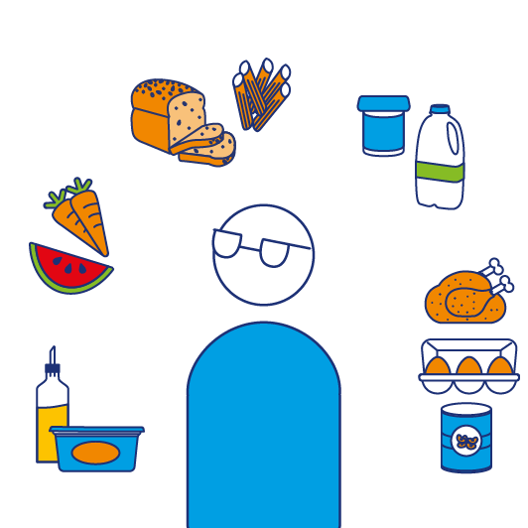
Participant bio— Healthy Eating Pattern Detective —2.1b
Course Title: Healthy Eating Keeps Doctors Away Estimated Time: 15 minutes
Activity Title:
 | Instructional Activity Description: Learners review peers’ Bio and comment on their current eating patterns with the guideline provided.
 | Activity Deliverables/Outcomes : Questions about current eating patterns Comments on MyPlate guidelines
 | Resources Required : Bios in the Discussion Board Personal laptops/computers/ tablets/ smartphones Fast and stable Internet connection What is MyPlate ? Webpage https://www.choosemyplate.gov/eathealthy/WhatIsMyPlate
Notes: This activity is a small step to take a close look at the MyPlate guideline by connecting learners personal experience. Understanding better about various characteristics of learners and their previous knowledge can best address their range of needs. Based on the general ideas of MyPlate guideline and communications between learners, they will have autonomy to choose peers to work in groups. It’s a warm-up activity to involve students with the content and peers before demonstrating the specific content beyond this in the next activity. The instructor will correct, remind learners or ask questions to facilitate the learners to explore deeper about healthy eating patterns. | Key learning outcomes: Learners will be able to distinguish healthy eating patterns from peers’ current eating patterns by reading the webpage What is MyPlate ? Learners will be able to apply the knowledge gained from MyPlate guidelines to critiquing peers’ eating patterns. Learners will be able to compare and contrast different eating patterns in the Discussion Board. Learners will be able to illustrate some healthy eating patterns.
 | Key Content Points: MyPlate guidelines
Introduction
Analysis
Demonstration
Assessment
Diabetes UK[Digital image]. (n.d.). What is a healthy, balanced diet for diabetes? Retrieved from https://www.diabetes.org.uk/guide-to-diabetes/enjoy-food/eating-with-diabetes/what-is-a-healthy-balanced-diet

Slide 11
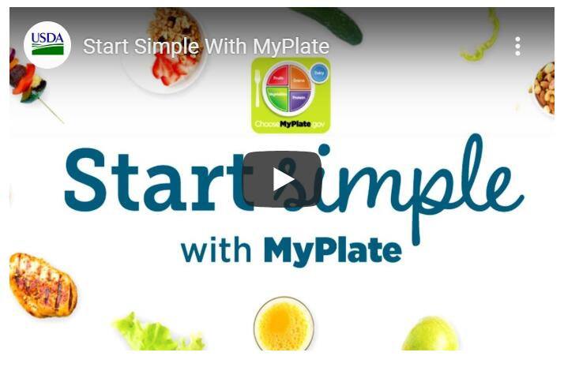
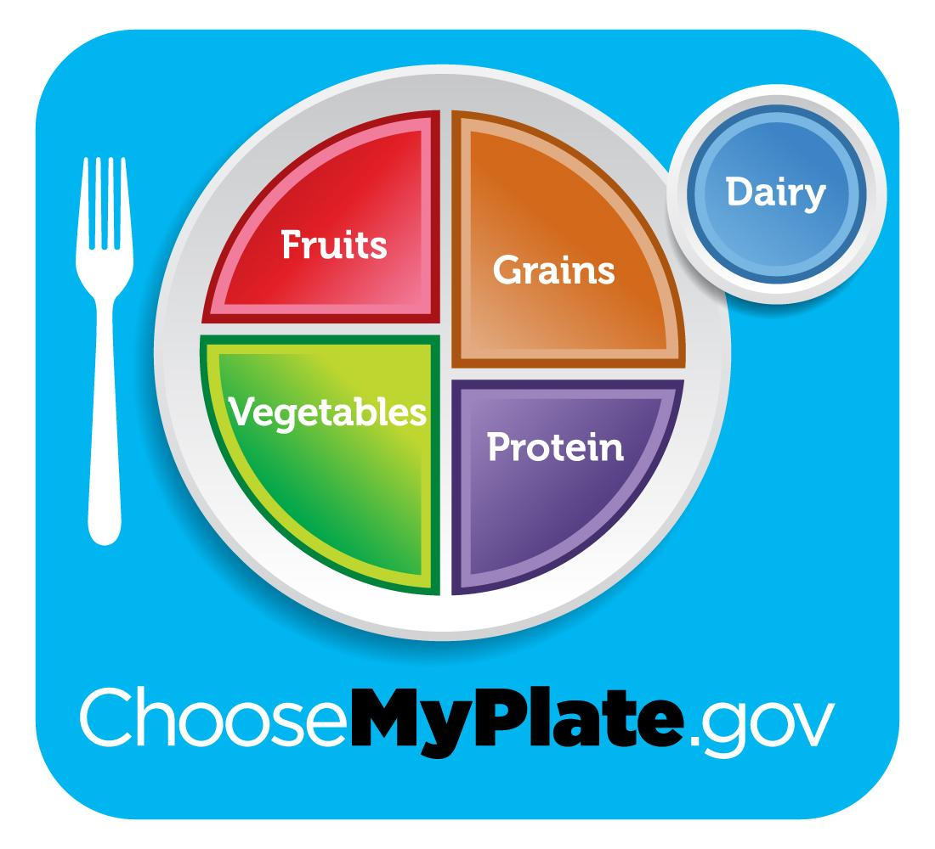



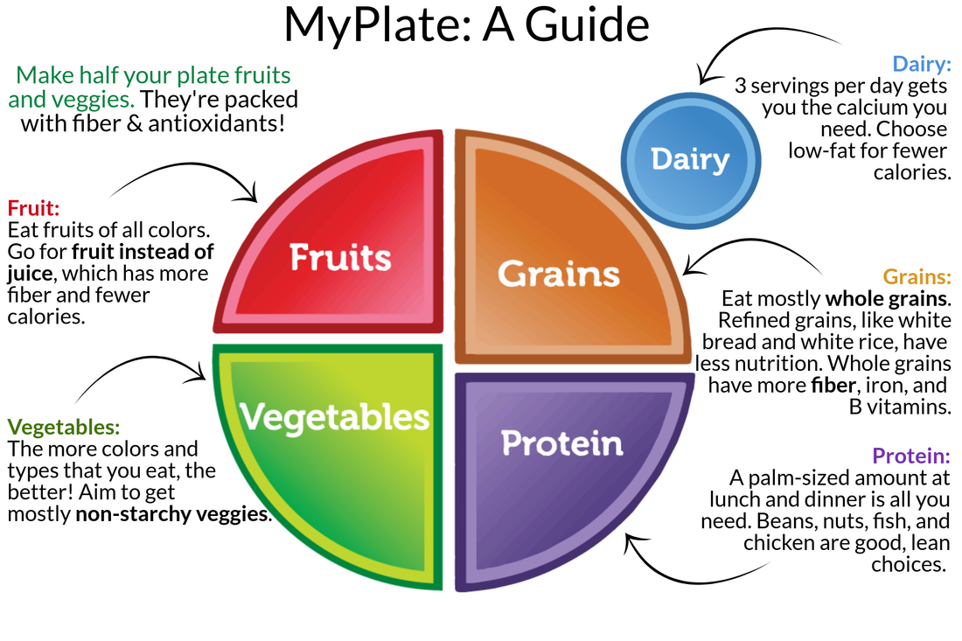
Course Title: Healthy Eating Keeps Doctors Away Estimated Time: 20 minutes
Activity Title:
Redesign the icon MyPlate —Video Conferencing —3.1a
 | Instructional Activity Description: Prompts learners to reflect last activity. Debriefs the benefits and drawbacks of last activity. The learners watch 2-minute tutorial Start Simple with MyPlate. Introduces learners to focus on the feature of icon MyPlate “simple but not informative” by using transition words. Learners will generate ideas by working in teams of 4. Presents the group project—Redesign the icon MyPlate to make it simple and informative Q/A
 | Activity Deliverables/Outcomes : Note-taking Feedback Recorded videos about the conference Numbers of Teams and members
 | Resources Required : Dietary guidelines for Americans 2015-2020(eighth edition)https://www.dietaryguidelines.gov/sites/default/files/2019-05/2015-2020_Dietary_Guidelines.pdf Personal laptops/computers/ tablets/ smartphones Fast and stable Internet connection The tutorial Start Simple with MyPlate Project resource package under the folder Unit 3
Notes: Instructor talk[Digital image].(2019). Online provider of English lessons. Retrieved from https://learntalk.org/en/teachers [Untitled illustration of a video conferencing] . Retrieved 2019 from https://www.freepik.com/free-vector/video-conferencing-concept-landing-page_4655367.htm The group project will be illustrated clearly and slowly by the instructor because it’s the core activity of this course. The content includes: rationale, resources, requirements and one example. The instructor and learners will use Blackboard Collaborate to have a conference. The conference will be recorded. | Key learning outcomes: Learners will be able to illustrate the food icon MyPlate.
 | Key Content Points: The introduction to the icon MyPlate.
Introduction
Analysis
Demonstration
Assessment

Slide 12
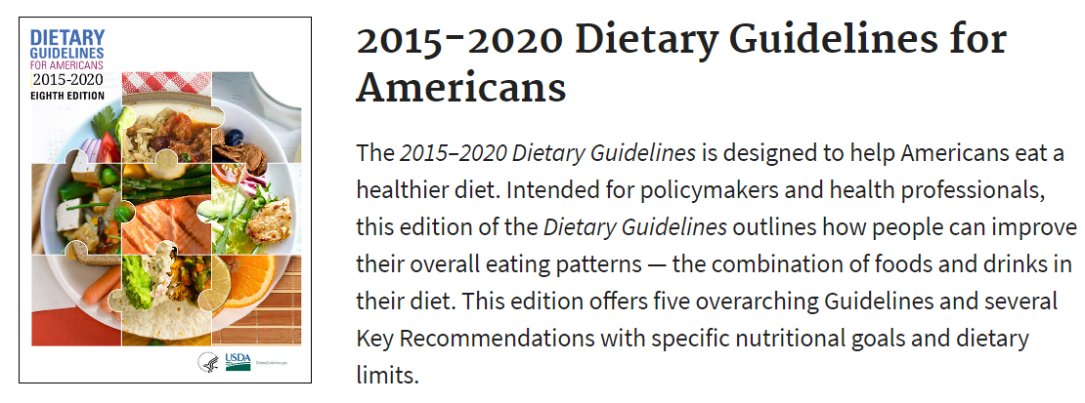
Course Title: Healthy Eating Keeps Doctors Away Estimated Time: 30 minutes (Offline)
Activity Title:
Redesign the icon MyPlate —Readings —3.1b
 | Instructional Activity Description: Presents the content of Dietary guidelines for Americans 2015-2020 Prompts learners to note information and questions to share with teammates next time.
 | Activity Deliverables/Outcomes : Notes of dietary guidelines
 | Resources Required : Dietary guidelines for Americans 2015-2020(eighth edition) https://www.dietaryguidelines.gov/sites/default/files/2019-05/2015-2020_Dietary_Guidelines.pdf
Notes: Learners will only focus on Introduction and Chapter 1 of Dietary guidelines for Americans 2015-2020. Learners will read offline individually to prepare for the discussion with teammates. | Key learning outcomes: Learners will be able to list the purpose of the Dietary Guidelines. Learners will be able to synthesize the Dietary Guidelines through MyPlate.
 | Key Content Points: Key points related to MyPlate icon
Introduction
Analysis
Demonstration
Assessment

Slide 13
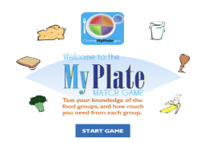
Course Title: Healthy Eating Keeps Doctors Away Estimated Time: 5 minutes
Activity Title:
Redesign the Icon MyPlate —MyPlate Matching Games —3.1c
 | Instructional Activity Description: Simulation on My Plate and play the online matching game.
 | Activity Deliverables/Outcomes : Individualized simulation learning.
 | Resources Required : Dietary guidelines for Americans 2015-2020(eighth edition)https://www.dietaryguidelines.gov/sites/default/files/2019-05/2015-2020_Dietary_Guidelines.pdf Access to the internet via personal computer or laptop. Link to “My Plate Match Game” via course Blackboard. https://www.healthyeating.org/Healthy-Kids/Kids-Games-Activities/My-Plate-Match-Game
Notes: It’s more than a game. It’s a different form to test learners’ knowledge of 5 groups and how much they need from the 5 groups. Learners will be highly engaged with Dietary guidelines by games. Children are encouraged to play the game with their parents. The link can be found in Unit 3 on Bb. | Key learning outcomes: Learners will be able to analyze the associations between eating patterns. Learners will be able to categorize foods by food group. Learners will be able to evaluate how much knowledge they have learned from the Dietary guidelines.
 | Key Content Points: Food group information and My Plate structure demonstrated through a matching game.
Introduction
Analysis
Demonstration
Assessment
Dairy Council of California. [Digital image].(2019). My Plate Match Game. Retrieved from https://www.healthyeating.org/Healthy-Kids/Kids-Games-Activities/My-Plate-Match-Game

Slide 14
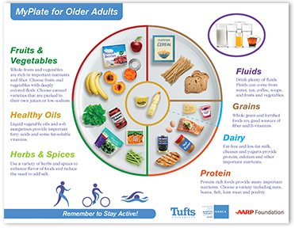
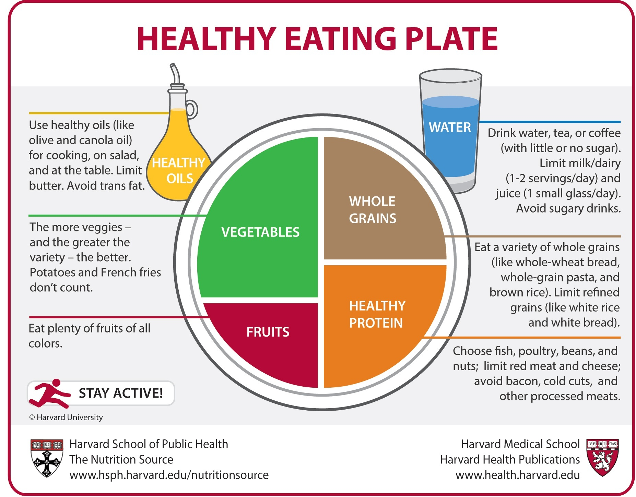
Course Title: Healthy Eating Keeps Doctors Away Estimated Time: 50 minutes(Offline)
Activity Title:
Redesign the icon MyPlate —A new Ready-to-use Healthy Eating Guide —3.1d
 | Instructional Activity Description: Learners work in groups of 4 to redesign the icon MyPlate with resources and one sample provided by instructor.
 | Activity Deliverables/Outcomes : Different designs of healthy eating guide
 | Resources Required : Dietary guidelines for Americans 2015-2020 (eighth edition) https://www.dietaryguidelines.gov/sites/default/files/2019-05/2015-2020_Dietary_Guidelines.pdf Personal laptops/computers/ tablets/ smartphones Fast and stable Internet connection
Notes: The icon MyPlate looks colorful and simple but it doesn’t offer enough useful information to help learners to follow healthy eating patterns. The redesign activity would inspire learners’ curiosity to make full use of dietary guidelines and other related resources to deliver an easy to use but specific guide. Learners will meet in person or virtually to finish the task before due dates. Learners will gain points and badges after they finish this task. | Key learning outcomes: Learners will be able to apply the knowledge of dietary guidelines to a new situation. Learners will be able to summarize the similarities of each food group. Learners will be able to differentiate different food groups by colors, amount, and kinds.
 | Key Content Points: the components in healthy eating patterns
Introduction
Analysis
Demonstration
Assessment
Illustration of MyPlate for old adults [Digital image].(2020).Retrieved from https://hnrca.tufts.edu/flipbook/resources/my-plate-for-older-adults/

Slide 15
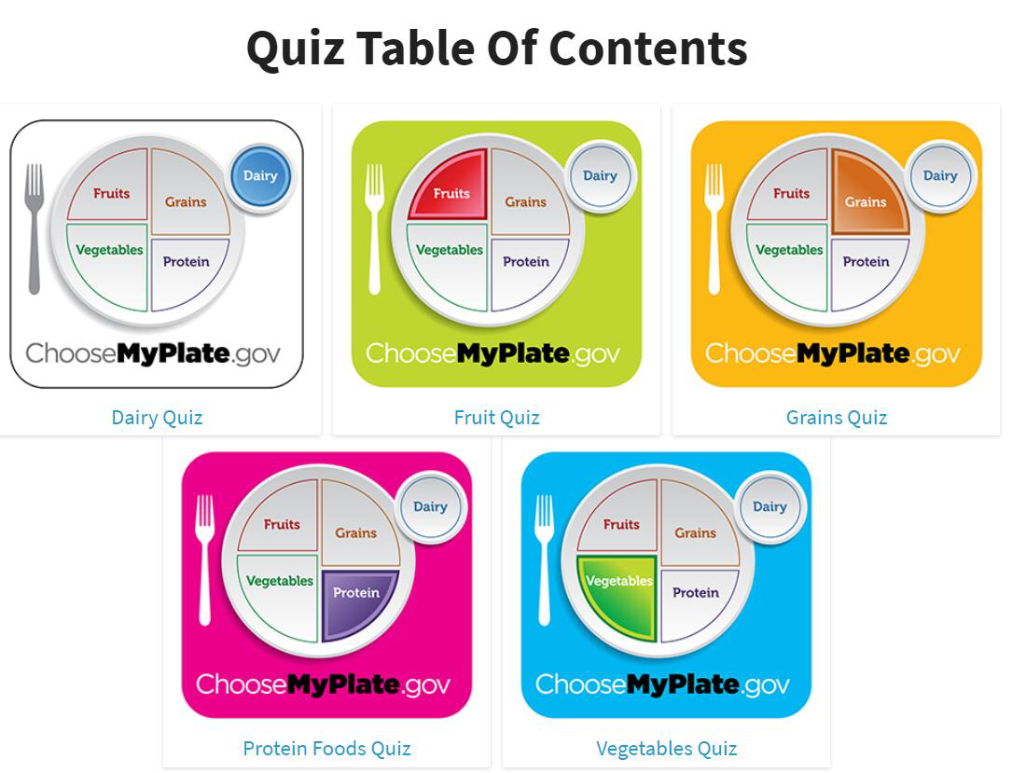
Course Title: Healthy Eating Keeps Doctors Away Estimated Time: 10 minutes
Activity Title:
Post-demo Quiz —3.2
 | Instructional Activity Description: Closed note on knowledge of My Plate five food groups and their structures. Match the questions with correct questions.
 | Activity Deliverables/Outcomes : The scores on post-demo quiz
 | Resources Required : Access to the internet via personal computer or laptop. Link to post-demo quiz via Bb. https://www.choosemyplate.gov/quiz
Notes: Learners will access the link in Unit 3 via Bb. Instructor gets immediate results from learners. Not only does the creator get the results, the participant itself is also possible to get his or her results. This makes it for the creator easy to identify the gaps in knowledge. The participants are able to view on what kind of section they have to improve themselves. Learners will gain points and badges after they finish post-demo quiz. | Key learning outcomes: Learners will be able to analyze the knowledge content from a different perspective. Learners will be able to synthesize information on dietary guidelines in a testable setting. Learners will be able to assess knowledge of 5 food groups by doing the quiz.
 | Key Content Points: Key nutrient contributions of each food group Considerations of each food group
Introduction
Analysis
Demonstration
Assessment

Slide 16
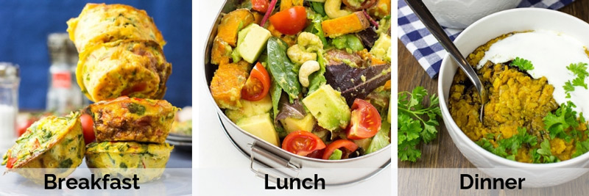
Course Title: Healthy Eating Keeps Doctors Away Estimated Time: 15 minutes
Activity Title:
Build 3 Healthy Meals for One Day—3.3
 | Instructional Activity Description: Presents videos and materials to scaffold learners to design 3 healthy meals. The learners read the materials. The learners sketch the recipe with the specific foods and drinks.
 | Activity Deliverables/Outcomes : The design of 3 healthy meals
 | Resources Required : Dietary guidelines for Americans 2015-2020(eighth edition) https://www.dietaryguidelines.gov/sites/default/files/2019-05/2015-2020_Dietary_Guidelines.pdf Choose MyPlate https://www.choosemyplate.gov/eathealthy/myplate-plan-action-guide MyPlate Plan https://www.choosemyplate.gov/resources/MyPlatePlan MyPlate, MyWins https://www.choosemyplate.gov/eathealthy/myplate-mywins Personal Google Accounts
Notes: Learners will access all the resources via Bb in the folder of Unit 3. Instructor will create new documents from the URL docs.google.com/create. Instructor will share the link of the file with learners in Unit 3 to keep them view, or comment on them. Learners will log in and follow the instruction to finish the task. Learners will gain points and badges after they share the design by Google Docs. | Key learning outcomes: Learners will be able to choose their favorite foods and drinks after they review videos and materials. Learners will be able to write 3 recipes based on available resources.
 | Key Content Points: Personalized meal plans with details about what and how much to eat within your calorie allowance.
Introduction
Analysis
Demonstration
Assessment
Fox, H.(2019, March 5). Get our 7-Day Vegetarian Weight Loss Meal Plan – Free to Download!Retrieved from https://hurrythefoodup.com/vegetarian-diet-weight-loss/

Slide 17

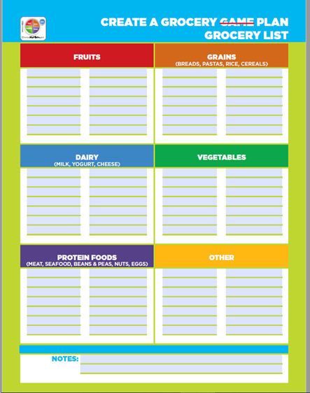
Course Title: Healthy Eating Keeps Doctors Away Estimated Time: 10 minutes
Activity Title:
Create a Healthy Grocery List for Families —A Shopping checklist—3.3
 | Instructional Activity Description: Learners use the template to write items in a healthy grocery list for families by following one of the new ready-to-use MyPlate Guides.
 | Activity Deliverables/Outcomes : Checklist
 | Resources Required : Dietary guidelines for Americans 2015-2020(eighth edition) https://www.dietaryguidelines.gov/sites/default/files/2019-05/2015-2020_Dietary_Guidelines.pdf New ready-to-use MyPlate Guides. A template checklist
Notes: Each creates a healthy grocery list and submit to Dropbox. The printable template checklist will be provided online in Unit 3. Learners can create the healthy grocery list with families. Learners will gain points and badges after submission on time and the quality of checklist. | Key learning outcomes: Learners will be able to choose healthy foods and the amounts from one MyPlate guide for the whole family. Learners will be able to create one a healthy grocery list for families.
 | Key Content Points: Creating the items for shopping
Introduction
Analysis
Demonstration
Assessment
The writer[Digital image]. (2020). Why writing + time = magic. Retrieved from https://www.writermag.com/improve-your-writing/fiction/why-writing-time-magic/

Slide 18
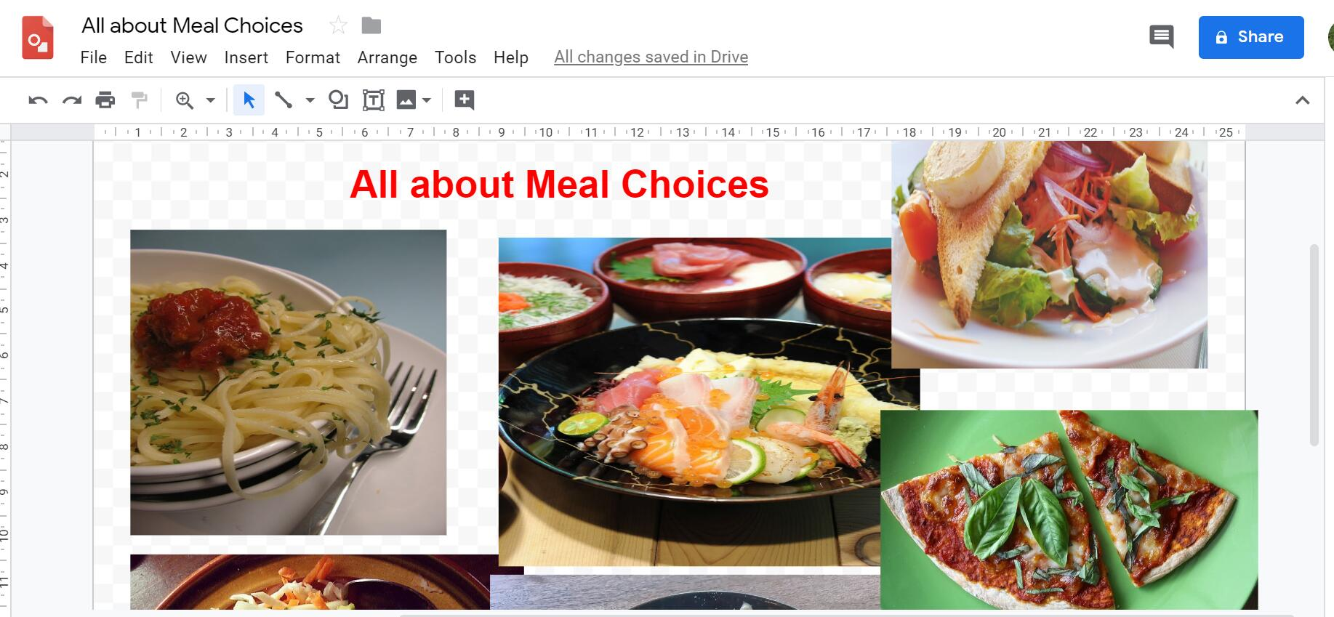
Course Title: Healthy Eating Keeps Doctors Away Estimated Time: 60 minutes（offline）
Activity Title:
All about Meal Choices —Meal Sharing—4.1a
 | Instructional Activity Description: Learners cook the 3 meals based on their own recipes. Learners post their favorite meals on Google Drawing.
 | Activity Deliverables/Outcomes : The layout of different meals.
 | Resources Required : Personal laptops/computers/ tablets/ smartphones Fast and stable Internet connection The link to post one favorite meal Google Accounts
Notes: Each learner will post one favorite meal to Google Drawing by using their Google Accounts. | Key learning outcomes: Learners will be able to demonstrate their meals by using resources about healthy eating patterns. Learners will be able to apply the recipes to real-life situation. Learners will be able to compare and contrast the design of meal.
 | Key Content Points: Using the recipes Sharing the meal
Introduction
Analysis
Demonstration
Assessment

Slide 19

Course Title: Healthy Eating Keeps Doctors Away Estimated Time: 15 minutes
Activity Title:
All about Meal Choices —Ask an Expert—4.1b
 | Instructional Activity Description: Shares the Google Mapping with USDA Expert and comment on the meals.
 | Activity Deliverables/Outcomes : Comments on each meal Questions learners might have
 | Resources Required : Personal laptops/computers/ tablets/ smartphones Fast and stable Internet connection The link to access all learners’ meals Google Accounts
Notes: Instructor will make appointments with USDA expert to talk about the activity to prepare early and better assist the students. Instructor will schedule a review time with learners including informing them the slot time, goals and preparation. Schedules will be made to keep instructor, USDA expert and learners synchronously communicate after learners review the comments from USDA expert to solve any questions learners might have. | Key learning outcomes: Learners will be able to access feedback from USDA expect to maintain or further improve their family meals. Learners will be able to describe questions based on the feedback.
 | Key Content Points: Communications on meals.
Introduction
Analysis
Demonstration
Assessment
FinTech Futures [Digital image]. (2019, November 6th). Ask the expert: your questions on growing the business answered. Retrieved from https://www.fintechfutures.com/2019/11/ask-the-expert-your-questions-on-growing-the-business-answered-12/

Slide 20

Course Title: Healthy Eating Keeps Doctors Away Estimated Time: 10 minutes
Activity Title:
Course Evaluation —4.2
 | Instructional Activity Description: Stimulates learners to complete the end-of-course evaluation in Unit 4 on Bb.
 | Activity Deliverables/Outcomes : Completion of evaluation
 | Resources Required : Personal laptops/computers/ tablets/ smartphones Internet connection Electronic end-of-course evaluation questionnaire
Notes: To decrease lower response rate, learners will gain points and a badge after they complete course evaluation. The course evaluation consists of 4 parts. They are student self-evaluation questions, instructor-specific questions, course-specific questions and open-ended questions. The course evaluation questionnaire items will be constructed on the sets of competencies below: a) Instructor Competencies ibstpiStandardsSet-Instructor2003-CompsOnly.pdf b) Online Learner Competencies ibstpiStandardsSet-OnlineLearner2012-CompsOnly.pdf | Key learning outcomes: The learners will be able to reflect the course content. The learners will critique the competencies of the instructor. The learners will value their own competencies after they take this course.
 | Key Content Points: Reflection of learners’ learning; Reflection of instructor’s teaching Course content
Introduction
Analysis
Demonstration
Assessment
4 Problems With Course Evaluations [Digital image]. Retrieved from https://www.getnclass.com/4-problems-with-evaluations/

Slide 21

Course Title: Healthy Eating Keeps Doctors Away Estimated Time: 30 minutes（offline）
Activity Title:
Reflective Journal —4.3
 | Instructional Activity Description: The learners write a journal with the resources available.
 | Activity Deliverables/Outcomes : A 3-paragraph narrative of personal thoughts, impressions, concerns or future plans.
 | Resources Required : Dietary guidelines for Americans 2015-2020(eighth edition) https://www.dietaryguidelines.gov/sites/default/files/2019-05/2015-2020_Dietary_Guidelines.pdf Leaderboards Report Checklist New MyPlate guide Discussions Groupwork Notes on the dietary guidelines and other resources Questions provided by instructor to prompt learners to think about how to write a reflective journal.
Notes: Learners will get the report of points and badges in the Leaderboards before they write the journal. This is an offline activity to make sure students have enough time to reflect what they have learned in the 120-minute online course and what activities they have done after learning the course content. | Key learning outcomes: Learners will be able to identify what are healthy eating patterns and their experience. Learners will be able to list what they think they have learned. Learners will be able to write how the course has changed their knowledge and thinking about eating habits.
 | Key Content Points: Available resources
Introduction
Analysis
Demonstration
Assessment
Online Journal[Digital image]. Retrieved from http://www.onlinejournal.com/reflective-journal-how-to

Slide 22
References:
Dicheva, D., Dichev, C., Agre, G., & Angelova, G. (2015). Gamification in education: A
systematic mapping study. Journal of Educational Technology & Society, 18(3), 75-88.
Grabowski, B. L., Beaudoin, M., Jung, I., Suzuki, K., & Kurtz, G. (2013). Online learner
competencies Information Age Publishing.
Klein, J. D., & ebrary, I. (2004). Instructor competencies: Standards for face-to-face, online,
and blended settings ([Rev. 3rd]. ed.). Greenwich, Conn: IAP--Information Age Pub.
Looyestyn, J., Kernot, J., Boshoff, K., Ryan, J., Edney, S., & Maher, C. (2017). Does
gamification increase engagement with online programs? A systematic review. PloS One,
12(3), e0173403. doi:10.1371/journal.pone.0173403
UC Regents.(2019). Berkeley center for teaching and learning. Retrieved from
https://teaching.berkeley.edu/
USDA Choose MyPlate. 2015-2020 Dietary Guidelines for Americans. Retrieved from
https://www.choosemyplate.gov/
U.S. DEPARTMENT OF AGRICULTURE. Retrieved from
https://www.choosemyplate.gov/eathealthy/WhatIsMyPlate

