Slide 1
In-Service Middle School English Teachers’ Perceptions of Their Beliefs, Knowledge, Practices in Developing Self-Regulated Learners in China
Lei Wang
Syracuse University
April 20, 2020

Slide 2
Background of the study
Fostering students’ ability to engage in effective self-regulated learning is an important goal of secondary education, as it prepares students for the demands of higher education or workplace learning(Dent and Koenka 2016).
As pressure to increase students’ academic success, students need to take ownership of their learning, to become self-regulated learners.
However, SRL does not naturally develop as children grow up (Baker, 2005; Bembenutty, 2011).
Additionally, according to Perry et al. (2008), most teachers agree with the concept to support their students to become self-regulated learners; yet many of the teachers that they investigated reported to feel unsure about how to do that.
empirical investigations of these issues have been conducted mainly in
Western countries. Relatively scant studies have focused on teachers’ roles in Asian countries and regions, such as mainland China.

Slide 3

Rationale of the study
Given the evidence that SRL can be taught to students, the importance of the teacher’s role in teaching students self-regulated learning strategies and skills cannot be over emphasized (Azevedo et al. 2008; Cazan 2013).
Teacher demographic variables have been noticed by researchers (Elmas, Demirdogen, and Geban, 2011; Lombaert et al. 2009; Lombaerts, Engels, and Vanderfaeillie 2007).
Empirical studies have demonstrated that teachers with positive beliefs toward SRL are more likely to promote student SRL in their teaching (Lombaerts, Engels, and van Braak 2009). However, other studies (e.g. Dignath-van Ewijk and van der Werf 2012; Spruce and Bol 2015) have reported contrasting results; that is, although teachers expressed positive beliefs about SRL, they did not include SRL strategy instruction in their classroom teaching.
This Photo by Unknown Author is licensed under CC BY-NC

Slide 4
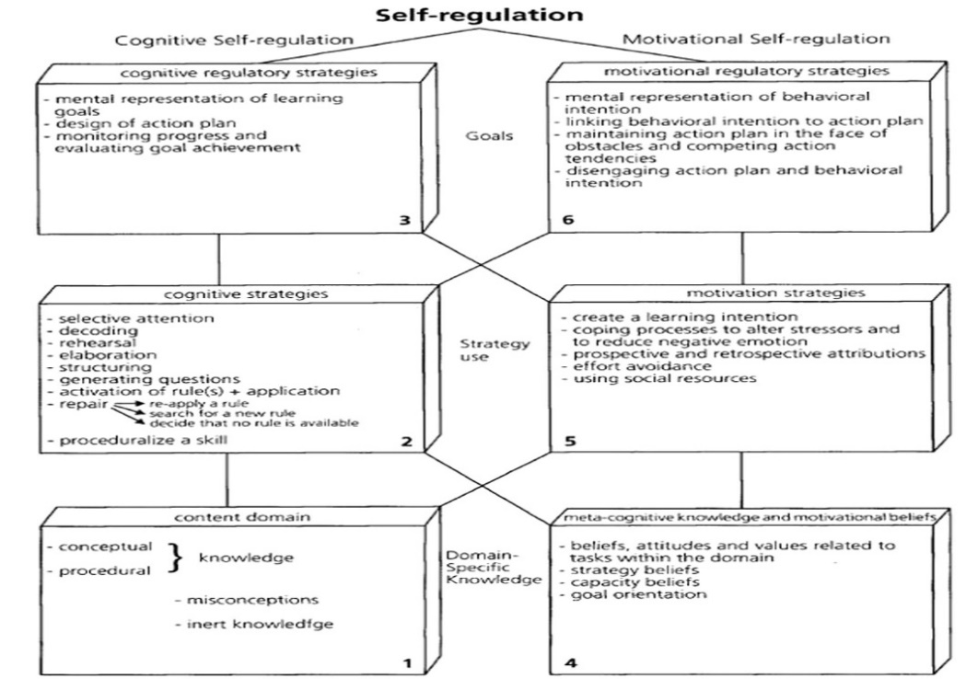

Teachers’ practices of self-regulated learning in the learning environment
This Photo by Unknown Author is licensed under CC BY-SA

Slide 5
Purpose
Accordingly, this present study focused on the variables important to develop self-regulated learners with the domain of Chinese middle schools.
The study aimed to investigate in-service English teachers' perceptions of their beliefs, knowledge and practices in developing self-regulated learners in middle schools in China.

Slide 6
Research questions
How do the English teachers in middle schools perceive the importance of teaching students SRL strategies and skills?
What are teachers' beliefs towards developing self-regulated learners?
What knowledge and practices do they use in developing self-regulated learners?
What factors impact the English teachers’ perceptions of teaching SRL strategies and skills in middle schools?

Slide 7
Participants
The participants consisted of 24 in-service teachers from middle schools in 2 regions, including Beijing and Henan province in China.
They both included male teachers (41.7 percent) and female teachers (54.2 percent).
Teachers all had experience using computers and Internet as well as teaching in schools for one year or more.
The participants’ age ranged from 25 to 54 years old. For this study the teachers from public schools and private schools were both included.

Slide 8

Research context
This study adopted the quantitative research approach using a cross-sectional survey for data collection.
For this purpose, the survey was conducted online by using a Chinese communication tool called WeChat.
The instrument used was a questionnaire that was developed to investigate in-service English teachers' perceptions of their beliefs, knowledge and practices in developing self-regulated learners in middle schools in China.
This Photo by Unknown Author is licensed under CC BY-NC

Slide 9
Instrumentation
A comprehensive questionnaire was developed by the author based on the literature review and her teaching experience.
The questionnaire consisted of four sections and was posted online in English considering the target participants were English teachers who were competent in English and had no language barriers in understanding the questions in the questionnaire.
Section 1 focused on collecting demographic data including gender, age, and teaching experience.
Section 2 contained 12 statements examining teachers’ beliefs towards SRL. Section 3 contained 4 statements examining teachers’ knowledge and practices towards SRL.
Section 4 contained 12 statements examining teachers’ perceptions of their students’ self-regulated learning practices.

Slide 10
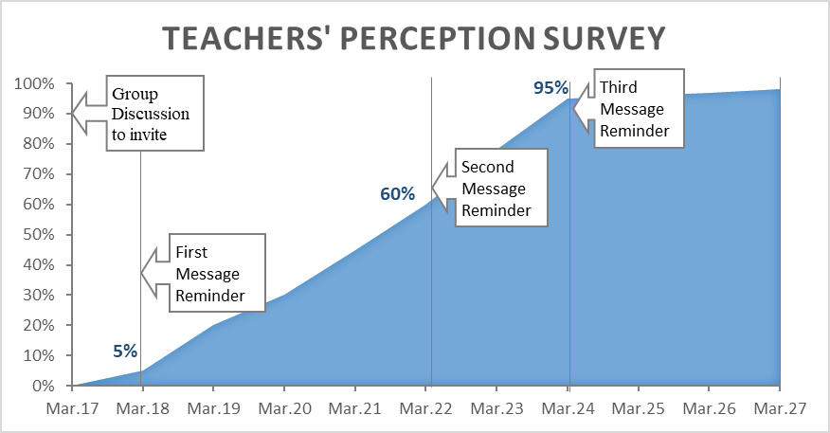
Research procedures

Slide 11
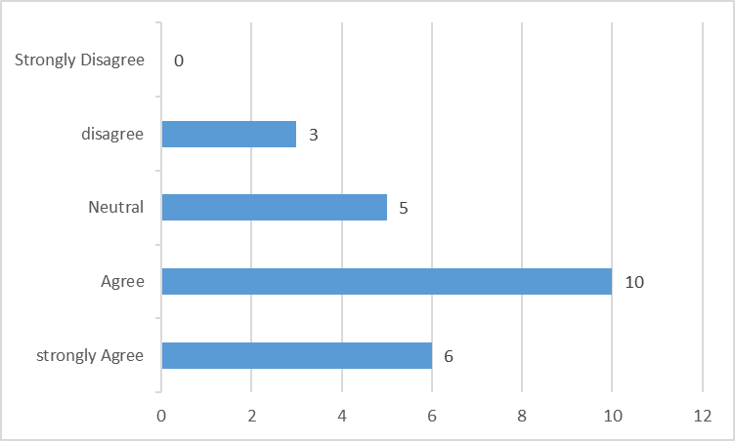
Findings with Research Question 1
In line with the research questions, these data were analyzed using SPSS 22.0, descriptive statistics and inferential multiple linear regression (MLR).
Research Question 1: The importance of teaching students SRL strategies and skills
Descriptive statistics were used to answer RQ1. The responses to Item 2 probing into in-service English teachers’ perceptions of the importance of teaching students SRL strategies and skills. With a Likert scale of 1-5, 1 being strongly agree and 5 strongly disagree, the mean scores of the importance of teaching students SRL strategies and skills was 1.61 while ranging from 1 to 4 scores chosen from 23 respondents, which means the mean score is between “strongly agree” and “agree” as seen in Table 1.（改成柱状图或饼图）

Slide 12
Findings with Research Question 2
Research Question 2: The teachers' beliefs towards developing self-regulated learners
Similarly, descriptive statistics were also used to answer RQ2. The mean scores of each item in Table 1 were moderately low, ranging from 1.43 to 2.27. The participants’ mean score is between “strongly agree” and “neutral” as seen in Table 1.

Slide 14
Findings with Research Question 3
Research Question 3: The knowledge and practices in developing self-regulated learners
Descriptive statistics were applied to answer RQ3.
The mean scores (Table 2) of teachers’ perceptions of their knowledge and practices in SRL are comparatively lower. The participants held the attitude between they “agree” and “neutral” towards the items.
As for the items used to investigate perceptions of their students’ self-regulated learning, teachers had lower mean scores in students self-regulated learning in goal settings, strategic planning and varying their strategic approach according to their periodic learning outcomes than feeling self-efficacious to achieve goals they set.

Slide 15
Table 2 Participants’ perceptions of their knowledge and practices in SRL
Field | Min | Max | Mean | Std | N
I have concrete experience in authentic self-regulated learning situations. | 1 | 5 | 2.13 | 1.076 | 24
I question my intuitive beliefs on self-regulation teaching, identify misapprehension, and replace them with new proper action. | 1 | 4 | 2.21 | .977 | 24
I am skillful in selecting and combining strategies to help my students arrange skills in their studies. | 1 | 4 | 2.13 | .900 | 24
I am skillful in selecting and combining strategies to help my students generalize questions. | 1 | 4 | 2.09 | .733 | 23

Slide 16
Table 3 Participants’ perceptions of their students’ self-regulated learning
Field | Min | Max | Mean | Std | N
My students can work towards their learning goals with my help. | 1 | 3 | 1.75 | .608 | 24
My students can reﬁne their learning goals when necessary with my help. | 1 | 3 | 1.87 | .626 | 23
My students can design their own action plans with my help. | 1 | 3 | 1.77 | .528 | 22
My students can extend or revise their own action plans when necessary with my help. | 1 | 3 | 1.91 | .684 | 22
My students have the ability to monitor their own behavior with my help. | 1 | 3 | 2.09 | .610 | 22
My students have the ability to detect mismatches in their learning with my help. | 1 | 4 | 2.18 | .853 | 22
My students have the ability to determine progress toward their goals with my help. | 1 | 4 | 1.95 | .722 | 22
My students are prompted to put in more eﬀort to study. | 1 | 4 | 2.10 | .944 | 21
My students have the ability to regulate their motivation with my help. | 1 | 4 | 1.95 | .669 | 21
My students have faith in their motivational regulatory strategies when they are learning by themselves. | 1 | 4 | 2.19 | .928 | 21
My students have the ability to reduce their negative emotion. | 1 | 5 | 2.43 | 1.076 | 21

Slide 17
Findings with Research Question 4
Research Question 4: Demographic factors impacting the English teachers’ perceptions of teaching SRL strategies and skills in middle schools
To address RQ4 to examine teachers’ demographic information predict, multiple regression analyses were conducted. English teachers’ perceptions of the importance of teaching SRL strategies and skills in middle schools were treated as the independent variable, with Teachers' demographic information predictors, along with other teacher characteristics including gender, age and teaching experience (In Table 4).

Slide 18
Table 4 Demographic information of Participants.
Demography Variable | N | %
Gender
Male | 10 | 41.7
Female | 13 | 54.2
Prefer not to say | 0 | 0.0
No response | 1 | 4.2
Age
Under 24 years old | 0 | 0.0
25-34 years old | 6 | 25.0
35-44 years old | 15 | 62.5
45-54 years old | 2 | 8.3
65 years old or older | 0 | 0.0
No response | 1 | 4.2
Teaching Experience
3 years or less | 3 | 12.5
4 to 8 years | 2 | 8.3
9 to 13 years | 5 | 20.8
14 years or more | 13 | 54.2
No response | 1 | 4.2
Total | 24 | 100

Slide 19
A multiple regression was run to predict the perceptions from gender, age, and teaching experience. These variables failed to statistically significantly predicted the perception, , F (23, 2.197) = 0.124; p < 0.005., R² = .268. All three variables failed to add statistically significantly to the prediction, p < .05.

Slide 20
Discussion 1
Based on the data the author collected, the mean of the items used for investigating teachers’ perceptions of their knowledge, beliefs and practices was less than 2.43, that means the room for self-regulation is very limited for the English teachers in Beijing and Henan province.
However, this is contrary to the literature and the interview conducted after the current study. In teaching practice, Zimmerman et. al (1996) indicated that few teachers effectively prepared students to self-regulate their learning processes. Schunk and Zimmerman(1998) pointed out educators generally accept the important role in behavior played by students’ self-regulatory activities, but they often do not know how to teach students self-regulatory skills or how to otherwise enhance students’ use of self-regulation principles in classrooms or other learning settings.

Slide 21
In the post-survey interview, some teachers reported that since this is a self-reported survey, teachers might have tended to choose positive responses to describe themselves. Taking a survey to measure teachers’ perceptions of SRL might be subjective. Having teachers explain SRL during interviews and observing its application in the classroom might be more objective.
Others indicated that they know how to use various cognitive strategies (rehearsal, elaboration and organization), how to plan, control and direct their mental processes towards achieving their students’ personal goals based on their teaching experiences and the principles and theories they have learned in universities.
Table 7 Information about taking parting in programs involving SRL
Field | N | %
Have you ever participated in any educational program involving self-regulated learning?
Yes | 2 | 8.3
No | 22 | 91.7
Total | 24 | 100

Slide 22
Discussion 2
The results didn't show significant differences based on demographic information. In other words, any of the demographic information didn't predict teachers' perceptions of the importance of teaching self-regulated learning strategies and skills.
The insignificance difference between male and female teachers didn't conform to the results of previous researchers( Elmas, Demirdöğen, and Geban ,2011; Wilkesmann and Lauer 2015) who reported gender difference might be attributed to the social roles for males and females to implement what or how to learn the course in universities.
Possible reasons: 1 intensive tests 2 teaching experience
More research should be conducted…

Slide 23
Limitation 1
The study encountered several risks, including the design of demographic questions, low response rate and other technological problems.
One mistake that was initially made was considering all the 75 responses from the Qualtrics as the sampling size. In actuality, there were only 24 responses. More attention should have been paid to the survey results and the duration of the instrumentation distribution. Even within the small sample size, there were still a few nonresponse errors. Those errors appeared in the demographic section and the last few questions of the other sections. Further research might consider requiring participants to complete all the questionnaire to reduce lower response rates.

Slide 24
Limitation 2
Who distributed the survey is also essential for conducting the survey design.
Although the think-aloud strategy was used to “train” the interviewers, it was informal. During the talk, teachers showed they were familiar with questions. They didn’t many questions about the instrumentation. In fact, teachers interpreted the questions in different ways. Having one administrator conduct the whole study together would be better control the high quality of responses.

Slide 25
Limitation 3
The sample size is too small and from specified chosen locations.
Therefore, this survey might not be generalized or applied on a large population. Data from this survey were collected in a few specific schools located in Beijing and Henan province. More than half of them are experienced teachers with 15-year or more teaching experience. Therefore, the results of the survey couldn’t represent an entire population.

Slide 26
Future research directions
As my colleagues mentioned, the survey design might involve response biases or response sets. Future investigations might make use of less subjective data, such as direct classroom observation and link teachers’ SRL beliefs with observation of their actual classroom practices.
Teachers at some point develop their own beliefs on the promotion of self-regulation based on their teaching experience. It is important to change teacher beliefs before this happens. Training should take place as early as possible.

Slide 27
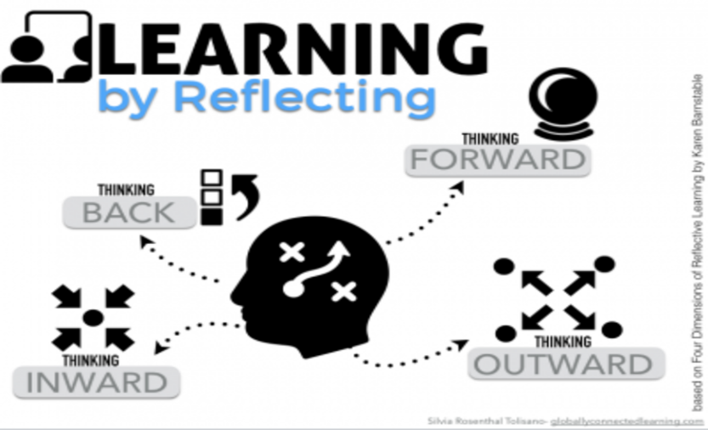
My own reflection
Not as optimistic as I was when I first knew this design
Is this the best design?
The quality of my instrument
Check for the reliability and validity of my instrument.
Take social and cultural factors into consideration
This Photo by Unknown Author is licensed under CC BY

Slide 28
References
Dent, A. L., & Koenka, A. C. (2016). The relation between self-regulated learning and academic achievement across childhood and adolescence: A meta-analysis. Educational Psychology Review, 28, 425-474. https://doi.org/10.1007/s10648-015-9320-8
Azevado, R., Moos, D., Greene, J., Winters, F., & Cromley, J. (2008). Why is externally-facilitated learning more effective than self-regulated learning with hypermedia? Education Technology Research Development, 56(1), 45-72.
Baker, L. (2005). Developmental differences in metacognition: implications for metacognitively oriented reading instruction. InS. E. Israel, C. C. Block, K. L. Bauserman, & K. Kinnucan-Welsch (Eds.), Metacognition in literacy learning: Theory, assessment, instruction, and professional development (pp.61-79). Mahwah, N. J.: L. Erlbaum Associates.
Bembenutty, H. (2011). Self-regulated learning: New directions for teaching and learning. Hoboken: John Wiley & Sons.
Perry, N. E., Hutchinson, L., & Thauberger, C. (2008). Talking about teaching self-regulated learning: Scaffolding student teachers’ development and use of practices that promote self-regulated learning. International Journal of Educational Research, 47(2), 97-108. doi:10.1016/j.ijer. 2007.11.010
Cazan, A. M. 2013. “Teaching Self-Regulated Learning Strategies for Psychology Students.” Procedia- Social and Behavioral Sciences 78: 743-747.
Elmas, R., B. Demirdogen, and O. Geban. 2011. “Preservice Chemistry Teachers' Images about Science Teaching in Their Future Classrooms.” Hacettepe University Journal of Education 40: 164-175.
Lombaerts, K., Engels, N., & van Braak, J. (2009). Determinants to teachers' recog­nitions of self-regulated learning practices in elementary education. The Journal of Educational Research, 102,163-173.
Lombaerts, K., N. Engels, and J. Vanderfaeillie. 2007. “Exploring Teachers' Actions to Promote Self-Regulated Learning Practices in Primary School.” The Australian Educational and Developmental Psychologist 24 (2): 4-24.
Lombaerts, K., N. Engels, and J. Vanderfaeillie. 2007. “Exploring Teachers' Actions to Promote Self-Regulated Learning Practices in Primary School.” The Australian Educational and Developmental Psychologist 24 (2): 4-24.
Lombaerts, K., N. Engels, and J. van Braak. 2009. “Determinants of Teachers' Recognitions of Self-Regulated Learning Practices in Elementary Education.” The Journal of Educational Research 102 (3): 163-174.
Dignath-van Ewijk, C., and G. van der Werf. 2012. “What Teachers Think about Self-Regulated Learning: Investigating Teacher Beliefs and Teacher Behavior of Enhancing Students' Self-Regulation” Education Research International 2012: 1-10.
Spruce, R., and L. Bol. 2015. “Teacher Beliefs, Knowledge, and Practice of Self-Regulated Learning.” Metacognition Learning 10 (2): 245-277.
Zimmerman, B. J., Bonner, S., & Kovach, R. (1996). Developing self-regulated learners: Beyond achievement to self-efficacy. Washington, DC: American Psychological Association.
Zimmerman, B., & Martinez-Pons, M. (1988). Construct validation of a strategy model of student self-regulated learning. Journal of Educational Psychology, 80(3), 284-290.
Elmas, R., B. Demirdogen, and O. Geban. 2011. “Preservice Chemistry Teachers' Images about Science Teaching in Their Future Classrooms.” Hacettepe University Journal of Education 40: 164-175.
Wilkesmann, U., and S. Lauer. 2015. “What Afects the Teaching Style of German Professors? Evidence from Two Nationwide Surveys.” Zeitschrift Für Erziehungswissenschaft 18 (4): 713–736.

Slide 29

This Photo by Unknown Author is licensed under CC BY-NC-ND

