Slide 1

AIN’T NO MAKIN’ IT:
ASPIRATIONS AND ATTAINMENT IN A LOW-INCOME NEIGHBORHOOD
JAY MACLEOD
(2009)

Slide 2

Agenda
Warm-up activity
Introduction to this book
Research purpose / question
Theoretical framework
Data collection methods and sampling procedures
Data analysis methods
Subjectivity
Findings / Conclusions
Personal reactions/Critique
Q & A

Slide 3

Standing in Other People's Shoes
What do you think about the idiom
“pull yourself up by your bootstraps”?
Did you pull yourself up by your bootstraps to get to where you are
in life today?
Warm-up activity

Slide 4
Introduction
Clarendon Heights, a low-income public housing project in a northern city.
documents class reproduc­tion by comparing how two groups of teenage boys experience their neigh­borhood, their school, and each other.
It centers around the lives of the Hallway Hangers and the Brothers, two groups of teenage boys who live in the same housing project.
MacLeod deftly situates his work within the social reproduction literature and develops an academic view­point in conversation with the streets.

Slide 5
RESEARCH PURPOSES & QUESTIONS

Slide 6
Research purpose / questions
Research Purpose
The study put great emphasis on the “occupational aspirations of the Brothers and the Hallway Hangers, how these aspirations are formed, and their significance for the reproduction of social inequality.(MacLeod, 2009, p. 8)”
Research Questions
How do they view their prospects for social upgrading, and how does this estimation affect their aspirations?
What unseen social and economic forces daily influence these boys?
How do they make sense of and act upon the complex and often contradictory messages emanating from their family, peer group, workplace, and school?
What is the cause of underachievement in low-income areas?

Slide 7
THEORETICAL FRAMEWORK

Slide 8
Theoretical Framework
Karl Marx, Paul Willis, Henry Giroux – social reproduction- analyzes how the class structure is reproduced from one generation to the next.
Pierre Bourdieu – cultural capital - explains how power in society is transferred and social classes maintain, including the general cultural background, knowledge, disposition, and skills that are passed from one generation to the next
Basil Bernstein – linguistic codes - ultimately are rooted in the social division of labor, derived from the social relations and roles within families

Slide 9
DATA COLLECTION AND SAMPLING PROCEDURES

Slide 10
DATA COLLECTION METHODS AND SAMPLING PROCEDURES
Data Collections Methods
Jay MacLeod immerses as a counselor in a youth program within the research site and also lived block away from the research site.
The data focus on the fifteen teenage boys who constitute the Brothers and the Hallway Hangers. Data was collected at all hours of the day and night.
Intensive 12 months of participant observation and series of unstructured interviews for Part I and Part II of the study and Part III had thirteen new interviews which was conducted about twenty-five years after the first data collection.
Field notes, transcripts of taped, semi-structured interviews with each boy (individually and, on occasion, in groups)make up the main body of the data.
Sampling Procedures
The researcher used a convenient sampling. As a counselor to the participants (Freddie, Slick, Steve, etc), the researcher lived blocks away and working as a youth counselor making his subject conveniently recruited into the study.

Slide 11
DATA ANALYSIS METHODS

Slide 12
Data Analysis Methods
Constant Comparative Method
Multi-data sources
Hallway Hangers
Brothers
Examines data for key issues, events, categories, and themes of focus
Collects more data that show more incidents of the focused themes
Looking for diversity within the themes.
Continued this same analysis over a relatively long period of time
Multiple sites
Clarendon Heights (first part of study)
Clarendon Heights, residences, jails, other locations (second and third part)

Slide 13
SUBJECTIVITY

Slide 14
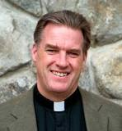
Subjectivity: Researcher’s Feelings, Opinions and Preferences
Who is Jay MacLeod?
  Childhood: rural New Hampshire, in a lower middle class family
  Education: Harvard BS in Sociology, Oxford University Rhodes Scholar
    conducted his research for Ain’t No Makin’ It in Boston, after working with a youth program
  Returned to conduct follow-up interviews with Hallway Hangers and the Brothers
  Social activist: Community Organizer in Rural Mississippi
    used his research findings in work with youths
  Ordained Anglican priest

Slide 15

Subjectivity: Researcher’s Feelings, Opinions and Preferences
Feelings and Opinions
  Based on interview with 14-18 year old boys believes that poverty is a result of societal structure in the US and NOT laziness, lack of willpower or personal moral failure
  Supports his ideas with sociological theory of Social Reproduction and Structuralism
    cultural capital and linguistic codes
  “The American Dream hides social inequalities.”
    revealed that stereotypes were not reality, need to unlearn assumptions
    https://www.western.edu/news/author-sccomplished-sociologist-jay-macleod-visits-western 14:15 - 15:17

Slide 16
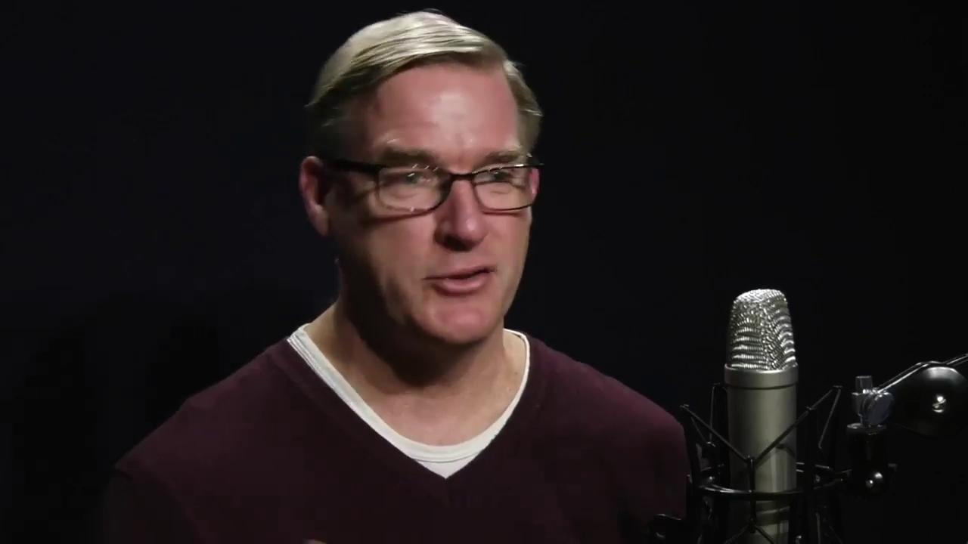
Subjectivity: Researcher’s Feelings, Opinions and Preferences
Preferences on Social Activism
  Does not attempt to convince people of position
  Creates opportunities for different social classes to interact and understand
  https://www.western.edu/news/author-sccomplished-sociologist-jay-macleod-visits-western 26:55 - 28:10

Slide 17
FINDINGS/CONCLUSIONS AND CRITIQUES

Slide 18
Findings / Conclusions
MacLeod’s subjectivity is shaped by his background, his interest, his desire to understand and provide a new perspective for poor youth and the middle class.
Ideally hoping to foster understanding and to change preconceived ideas for both.
MacLeod links how the social reproduction theories differ in the idea of deterministic theory and the role individual autonomy. He forges the argument about how inequality is created and sustained.
MacLeod helps the readers identify the causes of underachievement “leveled aspirations” in impoverished areas.

Slide 19
Personal Reactions/Critique
MacLeod’s success is owed to
  1. His ability to build rapport and trust with the Hallway Hangers and Brothers
  2. Suspend his own assumptions and stereotypes and to seek understanding
  3. Returning to Clarendon Heights in 3 stages enabled him to observe the outcomes he had anticipated
    Assumption: - Brothers would fulfill the achievement ideology and based on their hard work, positive attitude, and dedication to school
    Reality - Most were not getting ahead and remained in the same social class

Slide 20


Any thoughts, questions or comments?

